Slide 1
IV. NUCLEAR BIOCHEMISTRY
§4.3 DNA Replication
§4.3a DNA Replisome
§4.3b DNA Damage
§4.3c DNA Repair

Slide 2
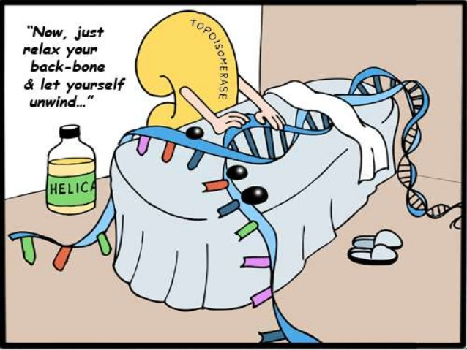
§4.3a DNA Replisome

Slide 3
Synopsis 4.3a
DNA replication involves making copies or “replicas” of DNA—or simply, producing two identical strand replicas from a parent DNA double helix
DNA replication requires partial unwinding of the two strands of the double helix so that each strand can serve as a template for the synthesis of a complementary daughter strand in a semi-conservative manner—what does that mean?!
DNA replication is primarily conducted by DNA polymerase—an umbrella term for a group of enzymes—though a myriad of other proteins are also involved in facilitating its action
DNA polymerase requires a template and primers to synthesize DNA
The molecular machine—comprised of DNA polymerase together with a myriad of other proteins—that carries out DNA replication has come to be known as the “replisome”

Slide 4
DNA Replication Models
Of the three theoretical possibilities, DNA replication occurs in a semi-conservative manner (a)—each of the two new copies of the double helix harbor one parent and one newly synthesized daughter strand!

Slide 5
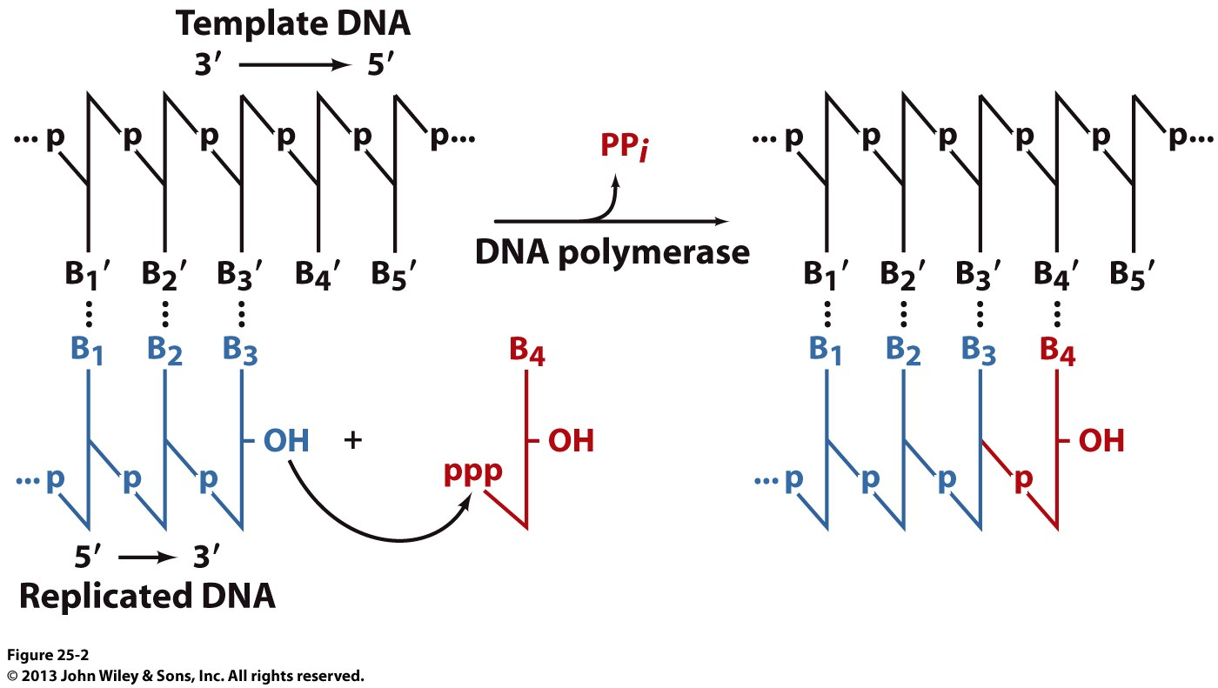
Replication Overview: DNA Polymerase
DNA polymerase uses a single-stranded DNA (ssDNA) as a parent template to catalyze the synthesis of a complementary daughter strand exclusively in the 5’→3’ direction
The reaction involves nucleophilic attack of the 3’-OH group (@ the 3’-end of the nascent/growing strand) on the α-phosphoryl group of an incoming nucleoside triphosphate (eg dCTP) with concomitant release of pyrophosphate (PPi) as a by-product
The incoming nucleoside triphosphate is selected on the basis of its ability to form Watson-Crick base pair with the corresponding base in the template strand @ the 3’-end

Slide 6
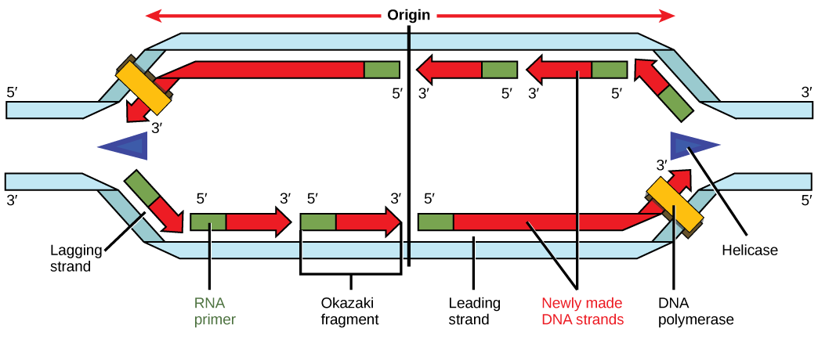
Replication Overview: Replication Bubble
Replication Fork
Replication Bubble
Replication Fork
Leading strand
Lagging strand
Lagging strand
Leading strand
Replication Origin
DNA replication requires the transient unwinding of DNA and strand separation at the so-called “replication origin”—the point of initiation of replication—so as to make each strand accessible to DNA polymerase
The resulting strand separation at the replication origin is called the “replication bubble” or “replication eye”
The branch points of the replication bubble are referred to as the “replication forks”
DNA synthesis proceeds in both directions at each of the two replication forks—it occurs in a bidirectional manner

Slide 7
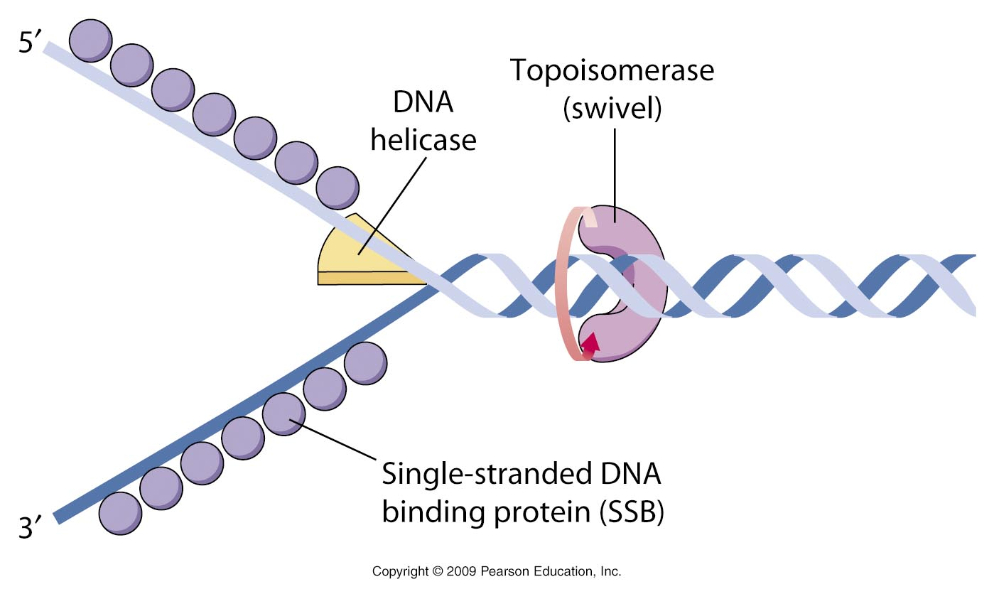
Replication Overview: Steric Players
SSB protein
Steric or spatial constraints present a special challenge during DNA replication—three major players involved in eliminating or keeping such constraints at bay are:
DNA helicase—mediates the unwinding of double-helical DNA at each replication fork
Topoisomerase—helps relieve the strain resulting from the overwinding (or supercoiling) of unwound DNA by virtue of its ability to inflict single- or double-stranded cuts
Single-stranded binding (SSB) protein—binds to single strands resulting from the unwinding of DNA and prevents them from re-annealing so as to facilitate the synthesis of complementary strands by DNA polymerase

Slide 8
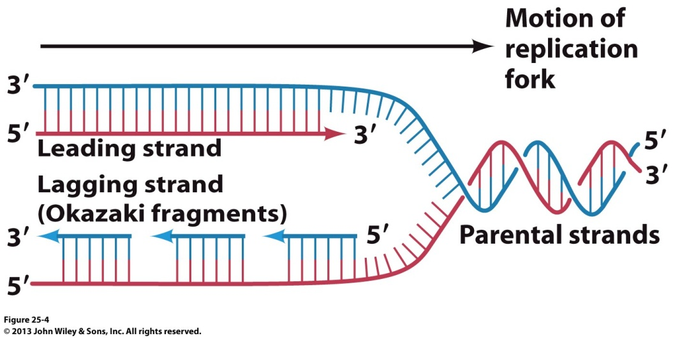
Replication Overview: Okazaki Fragments
Discontinuous
Continuous
Continuous
Discontinuous
Replication Origin
DNA replication at each of the two replication forks ensues in both directions using each of the two parent strands as templates in a simultaneous fashion
Using each of these two parent strands running in the 3’→5’ direction (colored blue) at the replication origin, DNA polymerase synthesizes a complementary strand in the 5’→3’ direction moving behind the advancing replication fork in a continuous manner on each parent strand—these complementary daughter strands synthesized in the direction toward the replication forks are called the “leading strands”
On the other hand, the two parent strands running in the 5’→3’ direction (colored red) at the replication origin are extended as short fragments termed “Okazaki fragments” in a discontinuous manner by DNA polymerase in the 5’→3’ direction as it moves away from the advancing replication forks—these complementary daughter strands synthesized in the direction away from the replication forks are called the “lagging strands”
In the lagging strands, the short Okazaki fragments (typically 100-200nt long) are eventually “cleaned up” and “stitched” together by a DNA ligase

Slide 9
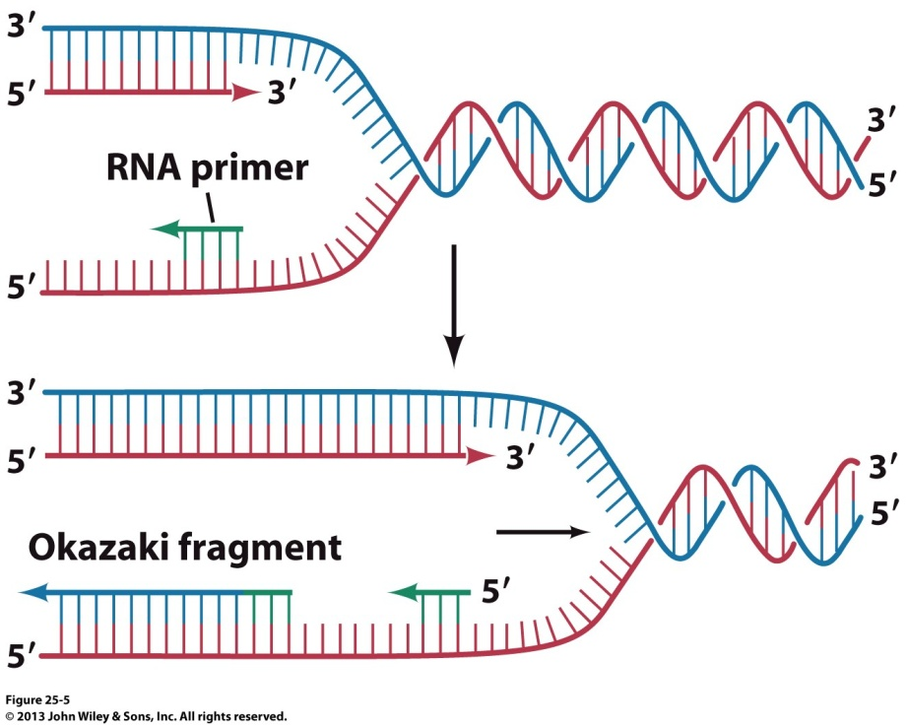
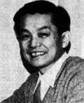
Replication Overview: RNA Primers
Reiji Okazaki
(1930-1975)
DNA polymerase cannot initiate the synthesis of a new complementary DNA strand—it rather only extends an exposed strand with a free 3’-OH group on a dsDNA—so what gives?!
In order to overcome this requirement of DNA polymerase, short RNA primers (typically 10-30nt long)—synthesized by DNA primase —hybridize with the exposed parent DNA strands as they separate at the replication origin
The free 3’-OH end of RNA primers is subsequently extended by DNA polymerase using the other strand as a template
While the synthesis of the leading strand requires only one RNA primer, multiple RNA primers are required for the synthesis of the Okazaki fragments on the lagging strand!

Slide 10
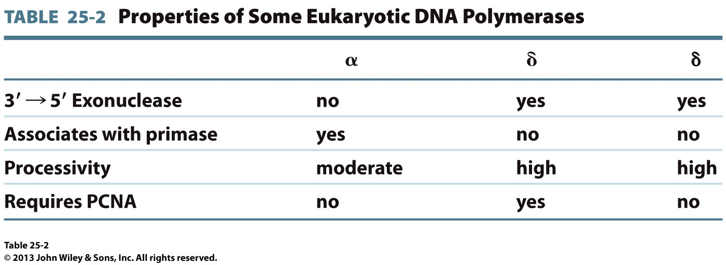
Replication Overview: DNA Polymerases
Polα
Polδ
Polε
Of more than a dozen DNA polymerases in eukaryotes, polymerase α (polα), polymerase δ (polδ), and polymerase ε (polε) reign supreme in DNA replication—their prokaryotic counterpart is polymerase III (polIII)
Other DNA polymerases primarily participate in processes such as DNA repair

Slide 11
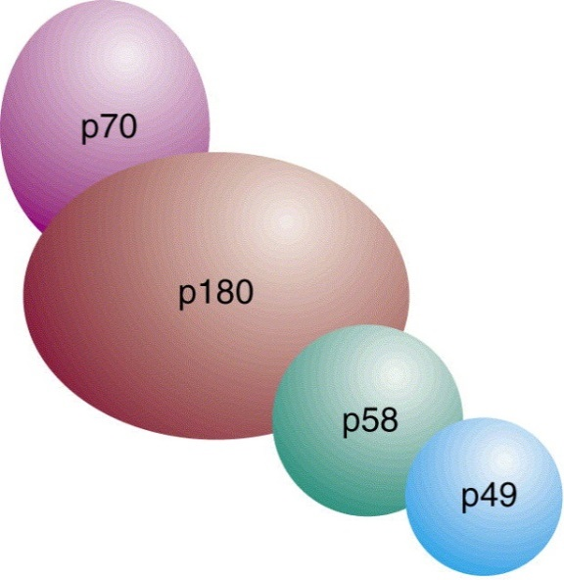
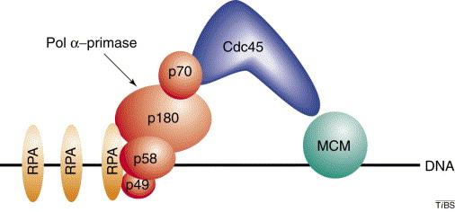
Replication Initiation: Polα
Polα
(p70+p180))
Primase (p58+p49))
Polα associates with DNA primase (polα-primase complex)—it is involved in initiating rather than elongating the synthesis of a complementary strand during DNA replication
Polα is devoid of 3’→5’ exonuclease activity—ie it cannot cleave nucleotides from the nascent 3’ end—why is that important?!
Ability to undertake such exo-cleavage is essential for a DNA polymerase to be able to “proof-read” and rectify errors in its own polymerization product!
Notably, polα harbors moderate processivity—it can only polymerize 10-20nt before it drops off the DNA template—its lack of proofreading ability is thus not problematic since these nucleotides along with RNA primer are eventually replaced in mature DNA (vide infra)

Slide 12
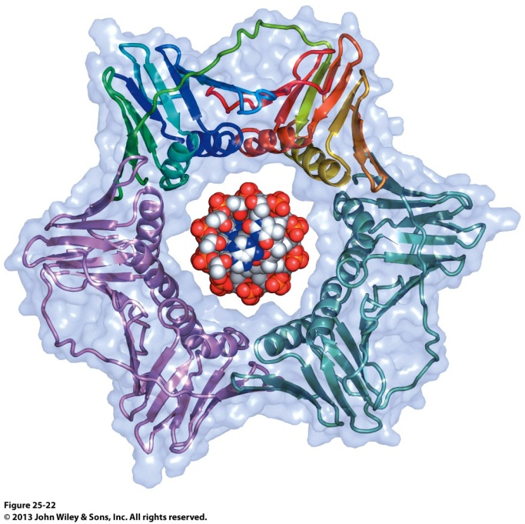
Replication Elongation: Polδ and Polε
Polδ and polε are the true workhorses of DNA
Replication—thanks largely to their 3’→5’ exonulcease
activities coupled with their high processivities—thus
rendering them ideally suited for the elongation of
each complementary strand
After the initiation of DNA replication, polε
and polδ respectively displace polα on the
leading and lagging strands
Polε is specialized for the continuous elongation
of the leading strand—its processivity is virtually
unlimited and it will go on for as long as it can
On the other hand, polδ is specialized for the
discontinuous synthesis of Okazaki fragments on the
lagging strand in a highly processive manner but only
when complexed with a ring-like protein that prevents its
dissociation from the DNA—such a ring-like protein is called “DNA clamp” or “sliding clamp”
In eukaryotes, the proliferating cell nuclear antigen (PCNA) serves as a ubiquitous DNA clamp during DNA replication
PCNA ring clamped onto a
DNA double-helix (center)

Slide 13
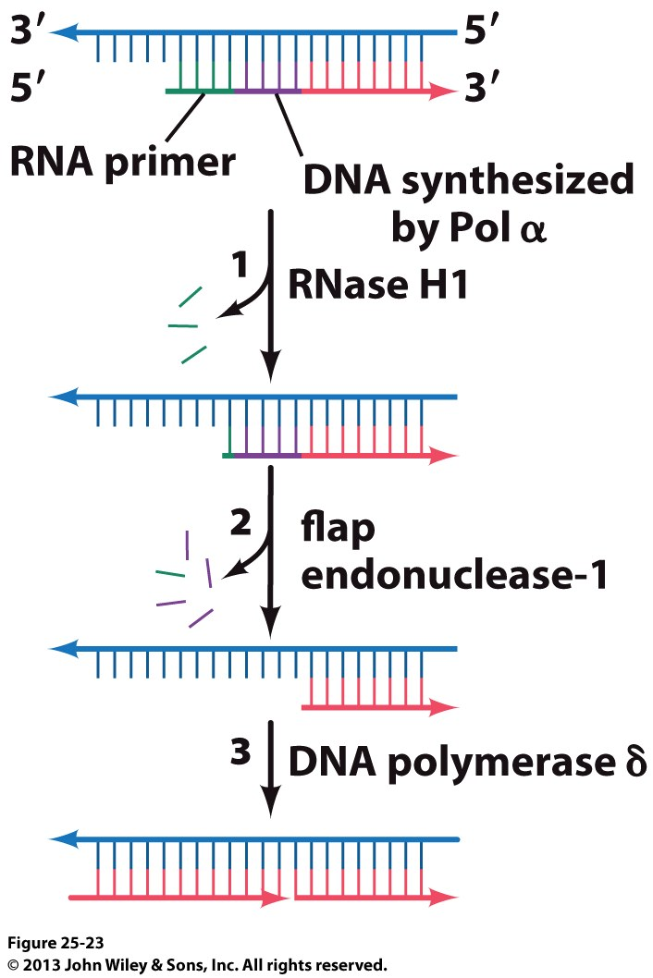
Replication Termination: Removal of RNA Primers
The final stage in DNA replication involves the removal of RNA primers from both the leading strand and the Okazaki fragments on the lagging strand—this “cleanup” task is delegated to two endonucleases named ribonuclease H1 (RNase H1) and flap endonuclease 1 (FEN1)
RNase H1 excises all but at least one 3’-ribonucleotide of the RNA primer
FEN1 then removes any remaining 5’-ribonucleotides within the RNA primer and, if necessary, any mismatched deoxyribonucleotides in the adjoining segment synthesized by polα during the initiation of DNA replication
The gap created by the excision of RNA primers and any mismatched DNA is subsequently filled in by polδ
The nicks are covalently stitched together by a DNA ligase in a subsequent step

Slide 14
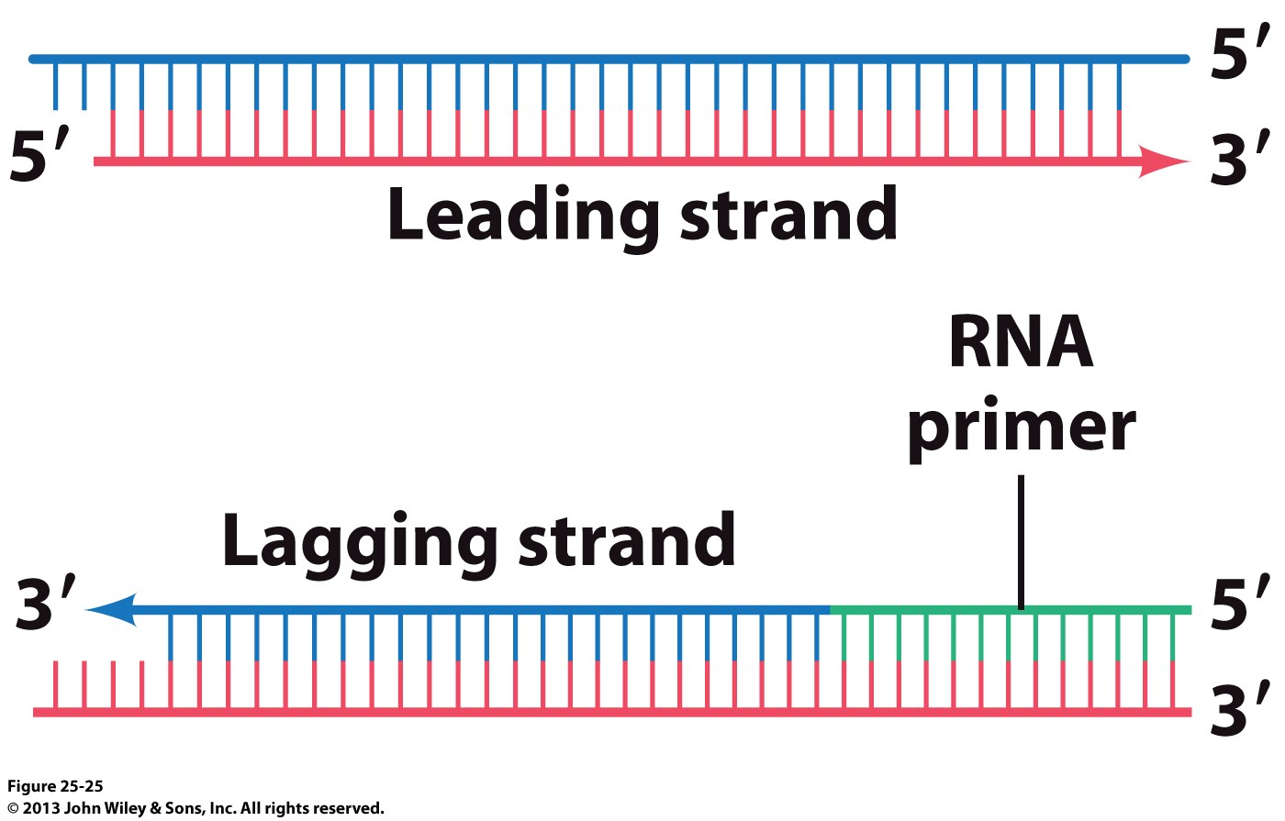
Telomeres: Chromosome Protection
While the synthesis of the leading strand proceeds all the way to the end, the same does not hold true for the synthesis of the lagging strand
Since RNA primer is required for the synthesis of the extreme 5’-end of the lagging strand, subsequent removal of this primer will expose the 3’-end of the template strand
The exposed 3’-end of the lagging-strand template will be subject to degradation (eg due to exonuclease action)—and thus resulting in chromosome shortening by at least tens of nucleotides per replication cycle
To overcome this problem, the ends of eukaryotic chromosomes harbor the so-called “telomeres”—from Greek => telo meaning “end” and mer meaning “part”
Why do prokaryotic chromosomes not harbor telomeres? Think circularly not linearly!

Slide 15
Teleomeres: D-Loop
Lagging strand synthesized using telomeres as a template
Lagging strand
RNA Primer
3’
AATCCCAATCCCAAUCCC-5’
5’
TTAGGGTTAGGGTTAGGGTTAGGGTTAGGG-3’
In order to safeguard against chromosome shortening, the 3’-ends of eukaryotic DNA harbor telomeres—a polynucleotide sequence comprised of 1000-2000 tandem repeats of G-rich 5’-TTAGGG-3’ motifs in vertebrates (or 5’-TTGGGG-3’ in protozoa)
This telomeric DNA strand—synthesized by telomerase—serves as a template for continuing the synthesis of a complementary lagging strand by DNA polymerase in a canonical fashion
The lagging strand is synthesized all the way from the 3’-end of the telomeric strand but the terminal 100-300nt (or 20-50 tandem repeats of 5’-TTAGGG-3’)—this terminal single-stranded G-rich short-stretch is called the “3’- overhang”
The 3’-overhang usually folds back and invades the double-stranded or duplex telomeric DNA via Watson-Crick base pairing to form what is referred to as the “D-loop” or displacement-loop
Telomeres
3’-overhang

Slide 16
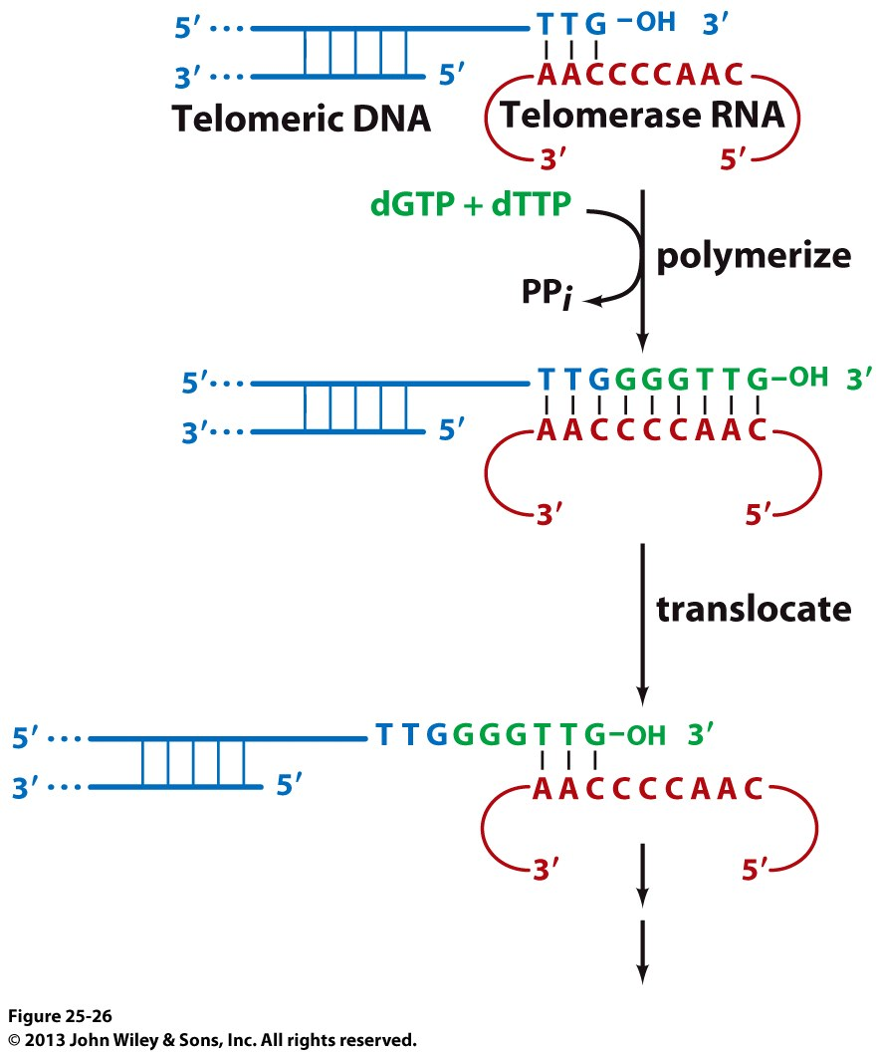
Telomeres: Telomerase
In order to prevent chromosome shortening, telomeres at chromosomal ends are constantly regenerated by telomerase
Telomerase is a ribonucleoprotein polymerase comprised of:
Telomerase reverse transcriptase (TeRT)—a protein
Telomerase RNA component (TeRC)—an RNA
TeRC contains a segment (∼400nt) that is complementary to telomeric sequence (eg 5’-TTGGGG-3’ in protozoa)
This TeRC segment serves as a “dynamic” template for TeRT to extend the 3’-end of G-rich telomeric DNA by adding telomeric repeats one at a time and then translocating to the newly synthesized 3’-end –this step is repeated until over 1000 telomeric repeats are added
The newly extended G-rich strand is then used as a template to synthesize complementary lagging strand (via Okazaki fragments) in a canonical fashion
Telomerase is of therapeutic significance:
Hyperactivation of telomerase is associated
with uncontrolled/neoplastic cellular growth resulting in
many forms of cancer
Hypoactivation of telomerase leads to gradual truncation of chromosomes and the inability of cells to divide (senescence) resulting in premature aging

Slide 17
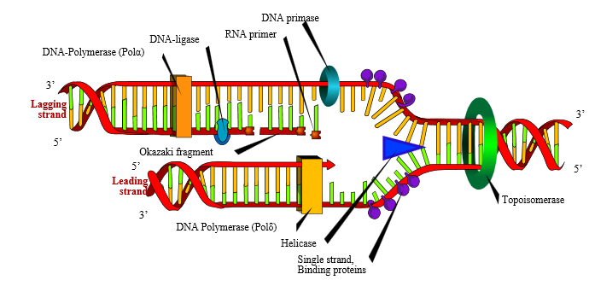
Replisome: Replication Machinery
RNase H1
DNA Ligase
Polα
DNA Primase
Polδ
FEN1
3’
RNA Primer
5’
3’
DNA Clamp
Okazaki Fragment
5’
5’
3’
Topoisomerase
Polε
DNA Helicase
SSB Protein
Polα DNA Polymerase α
Polδ DNA Polymerase δ
Polε DNA Polymerase ε
SSB Single-stranded binding
FEN1 Flap endonuclease 1
RNase H1 Ribonuclease H1

Slide 18
Replisome: Enzymes
Enzyme | Function
DNA helicase | Unwinds DNA double helix at each replication fork
Topoisomerase | Relieves strain resulting from overwinding and supercoiling of DNA
SSB protein | Stabilizes unwound DNA single strands and prevents them from re-annealing
DNA primase | Synthesizes RNA primers so as to kick off DNA replication on each strand
Polα | Extends the RNA primer laid down by DNA primase
Polε | Elongates the nascent leading strand initiated by polα
Polδ | Elongates the nascent lagging strand initiated by polα
DNA clamp | Imparts processivity upon polδ by preventing its dissociation from DNA
RNase H1 | Removes the RNA primers during the final stage of DNA replication
FEN1 | Removes mismatched nucleotides synthesized by polα
DNA ligase | Facilitates the stitching together of DNA strands via phosphodiester bonds

Slide 19
Exercise 4.3a
Explain why DNA polymerase requires a template and a primer
Why must DNA be replicated semidiscontinuously?
Describe the roles of DNA helicase, topoisomerase, and SSB in DNA synthesis
Describe the roles of polα, polδ and polε in DNA synthesis
Why do RNase H1, FEN1 and DNA ligase participate in DNA synthesis?
Describe the role of telomeres in DNA synthesis

Slide 20
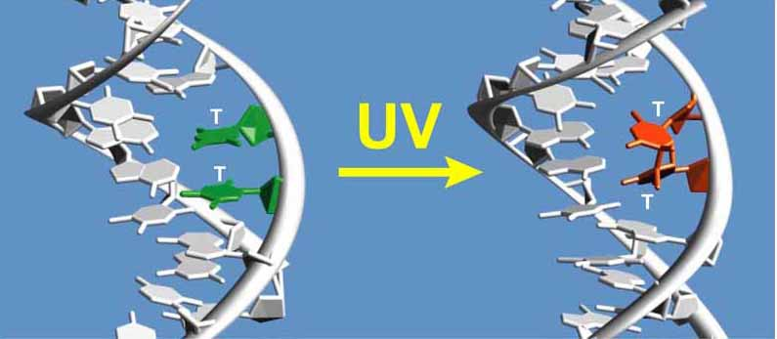
§4.3b DNA Damage

Slide 21
Synopsis 4.3b
The fidelity/accuracy of DNA replication is of paramount importance for the lack of it can result in the alteration of nucleotide sequence of genes with potentially devastating consequences
In addition to the endogenous introduction of such nucleotide changes, DNA can also be altered by a diverse array of external physical and chemical agents—such alteration is termed “DNA damage”
Physical agents include the UV and ionizing radaitions
Chemical agents include reactive oxygen species (ROS) , deaminating agents, and intercalating agents

Slide 22
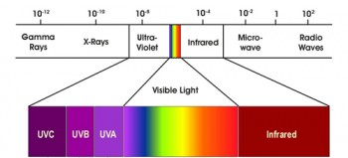
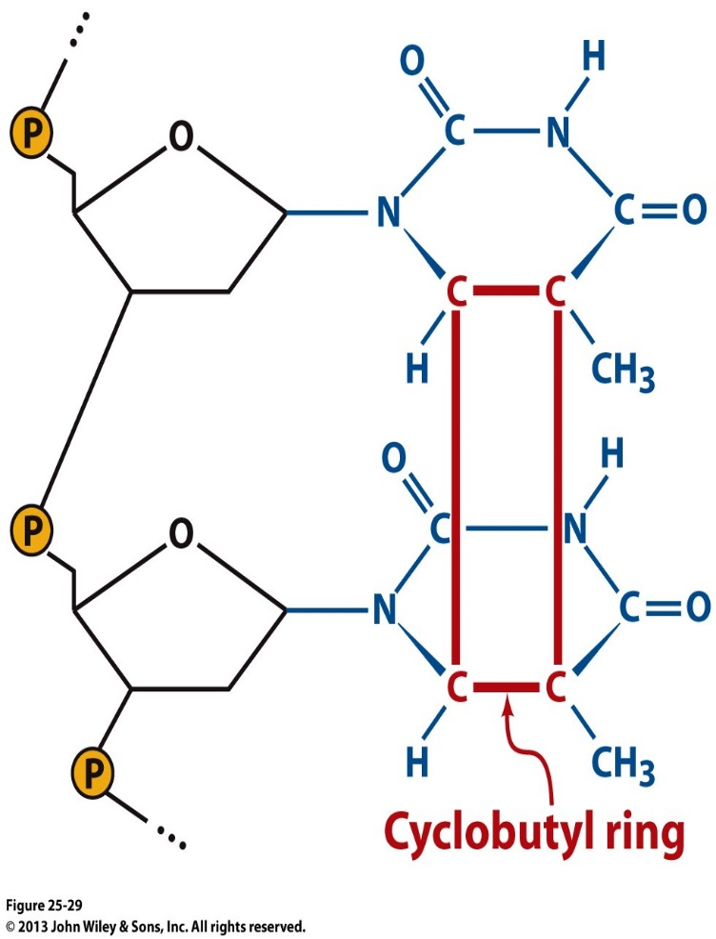
DNA Damage: Physical Agents
Two major physical agents that can cause DNA damage are:
(1) Ultraviolet (UV) light
(2) Ionizing radiation (eg γ-rays and x-rays)
In particular, sustained exposure to UV light (λ ≈ 10-350nm) promotes the formation of a cyclobutyl ring between thymine residues on the same strand within DNA
Such intra-strand dimerization brings the two thymine bases within ~1.6Å—but the distance between two stacked bases in DNA ought to be 3.4Å!—recall §4.2
Thymine dimerization thus shrinks the strand resulting in DNA distortion—that can ultimately interfere with the fidelity of processes such as DNA replication and RNA transcription
On the other hand, ionizing radiation (λ ≈ 10pm-10nm) harbors sufficient energy to damage DNA either directly by knocking electrons out of chemical moieties within DNA, thereby producing ions—or indirectly by inducing the formation of free radicals such as hydroxyl radical (HO.)
Such ions and free radicals generated by ionizing radiation
can induce the chemical cleavage of DNA strands
deoxyribose
thymine
deoxyribose
thymine
Formation of a cyclobutyl ring between two intra-strand thymine bases in DNA

Slide 23
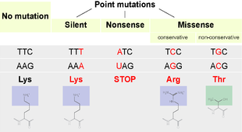
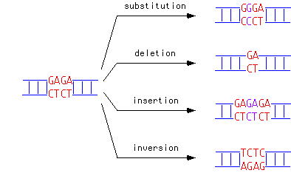
DNA Damage: Chemical Agents
DNA
mRNA
Protein
Normal/Native
Protein
Incomplete/Truncated
Protein
Defective/Inactive
Protein
Types of Mutations
Effect of Mutations
Chemical agents that induce mutations within DNA are called “mutagens”—mutagens that cause cancer are called “carcinogens”—but not all carcinogens are mutagens (!) as they can also induce cancer via interference with cellular processes
While the diversity of such mutagens is enormous, they all inflict DNA damage via two major mechanisms:
(a) Point mutations—substitution of a base pair with another in DNA
(b) Insertion/deletion mutations—insertion/deletion of one or more base pairs in DNA
Three major classes of mutagens that cause DNA damage include:
(1) Reactive oxygen species—eg hydroxyl radical (HO.)
(2) Deaminating agents—eg nitrous acid (HNO₂)
(3) Intercalating agents—eg ethidium bromide (EtBr)

Slide 24
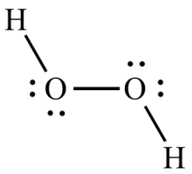
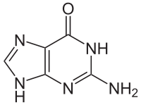
DNA Damage: (1) Reactive Oxygen Species
Oxidation
Hydroxyl
ion
Hydroxyl
radical
Hydrogen
peroxide
Reactive oxygen species (ROS) such as hydroxyl radical (HO.) and hydrogen peroxide (H₂O₂) are normal by-products of oxidative metabolism
Although ROS play important cellular roles, they rapidly accumulate to dangerous levels under conditions such as cellular stress—induced by factors such as UV exposure or depression
Under cellular stress, ROS can induce oxidative damage to DNA by virtue of their ability to cause oxidative modifications of bases—eg guanine (G) can be oxidized to 8-oxoguanine (O)
In addition to cytosine (C), O can also base pair with adenine (A)—thereby causing the following substitution during DNA replication:
G/C (O/C) → O/A → T/A
Guanine
Non-Watson-Crick Base Pairing

Slide 25
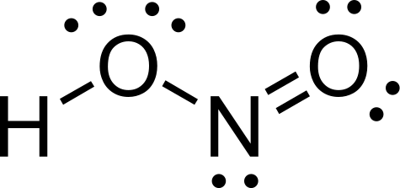
DNA Damage: (2) Deaminating Agents
Nitrous acid
Oxidative Deamination of Cytosine
Deaminating agents such as nitrous acid (HNO₂) can oxidatively deaminate DNA bases—eg cytosine (C) and adenine (A) are respectively deaminated to uracil (U) and hypoxanthine (I)
Since U base pairs with A, deamination of C can cause the following substitution during DNA replication:
C/G (U/G) → U/A → T/A
Since I preferentially base pairs with C, deamination of A can cause the following substitution during DNA replication:
A/T (I/T) → I/C → G/C
Oxidative Deamination of Adenine

Slide 26
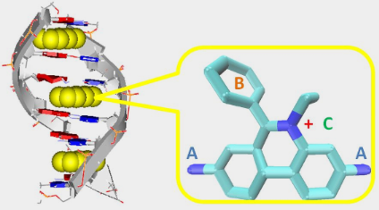
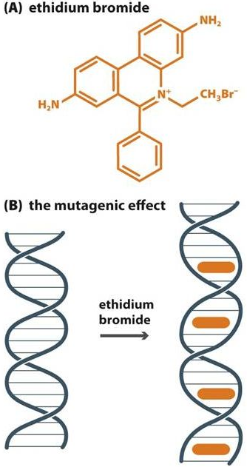
DNA Damage: (3) Intercalating Agents
DNA
Intercalation of DNA by EtBr
Intercalating agents—such as ethidium bromide (EtBr)—insert themselves between repeating layers of paired bases on DNA strands
In so intercalating, such agents usually double the distance between adjacent base pairs from 3.4Å to around 6Å
Such stretching and distortion of double helix can usually result in the deletion or insertion of additional nucleotides during DNA replication and transcription

Slide 27
Exercise 4.3b
List chemical agents that can alter DNA
List physical agents that can alter DNA
What are UV and ionizing radiations?
Describe the different kinds of DNA mutations
Must a carcinogen also be a mutagen?

Slide 28
§4.3c DNA Repair

Slide 29
Synopsis 4.3c
In order to combat a myriad of chemical and physical agents that can cause DNA damage, the cell has also evolved to adapt an equally impressive array of DNA repair mechanisms
Such DNA repair mechanisms target DNA at all levels from the removal of a single damaged base through single-strand gap filling to double-strand sealing
While DNA damage can often be repaired, the error-prone nature of “DNA repair” machinery can result in inaccuracies leading to changes in nucleotide sequence of genes producing one or more “mutations”
Such mutations in germline cells (eg ova and sperm) are particularly damaging as they can be passed onto the offspring
In contrast, mutations in somatic cells (eg hepatocytes and osteocytes) are usually harmless but can occasionally lead to malignant transformation of cells giving rise to cancer

Slide 30
DNA Repair: Common Mechanisms
DNA Repair Mechanisms
Direct Reversal (DR)
Single Strand Damage (SSD)
Double Strand Break (DSB)
Base Excision Repair (BER)
Nucleotide Excision Repair (NER)
Mismatch Repair (MMR)
In order to maintain the integrity of genetic information, cells harbor a wide variety of repair mechanisms attuned to specific types of DNA damage
Common mechanisms involved in repairing DNA damage include:
(1) Direct Reversal (DR)
(2) Single Strand Damage (SSD)
(3) Double Strand Break (DSB)

Slide 31
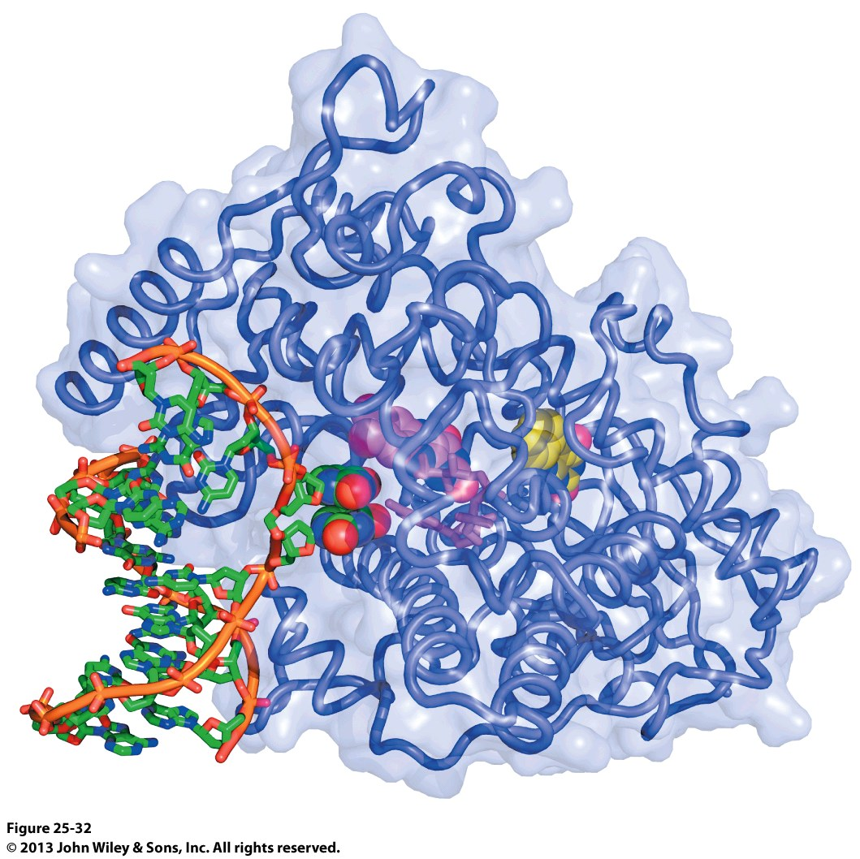
DNA Repair: Direct Reversal (DR)
deoxyribose
thymine
deoxyribose
thymine
Formation of a cyclobutyl ring between two intra-strand thymine bases in DNA
Crystal structure of DNA photolyase in complex with a dsDNA harboring a thymine dimer
DNA damage such as the formation of thymine dimers due to UV exposure can be directly restored by light-absorbing enzymes such as DNA photolyase in a process called “Direct Reversal”
DNA photolyase specifically recognizes the dsDNA containing pyrimidine dimers and catalyzes the cleavage of cyclobutyl ring between two pyrimidines in a reaction referred to as “photoreactivation”
Photoreactivation is made possible by the absorption of a photon of UV/blue light (300nm-500nm) by DNA photolyase and subsequently transferring the excitation energy to break the cyclobutyl ring

Slide 32
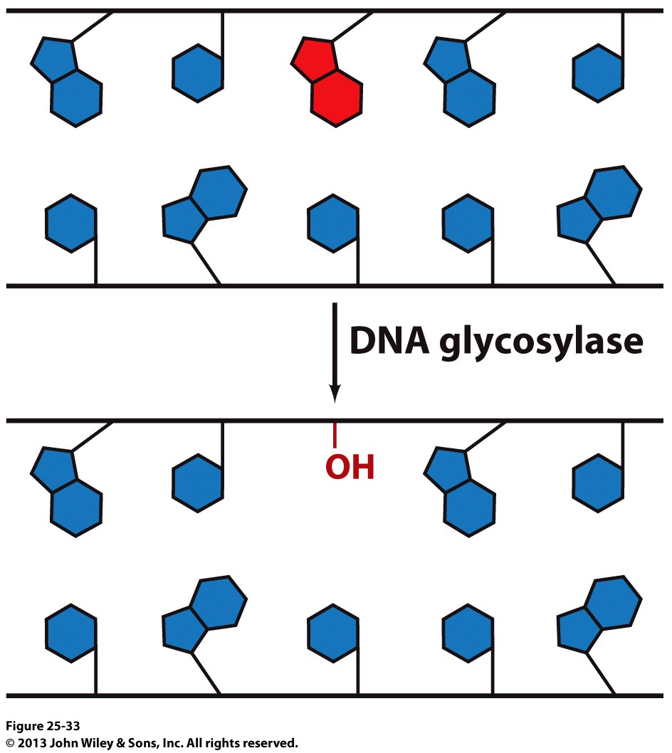
DNA Repair: SSD—Base Excision Repair (BER)
Chemically modified or damaged bases (eg 8-oxoguanine, uracil, hypoxanthine) that cannot be restored to their normal state by DR become subject to a second line of repair mechanisms known as “base excision repair (BER)”
In BER, the damaged base is removed by DNA glycosylases that cleave the corresponding N-glycosidic bond leaving behind a “base-free” deoxyribose—such a deoxyribose without an attached nitrogenous base is referred to as the AP (apurinic/apyrimidinic) site or abasic site
The deoxyribose coupled with several adjacent nucleotides are then excised out by the combined action of a cocktail of endonucleases and exonucleases
The resulting gap is filled in by DNA polymerases such as polβ and polλ
DNA ligase subsequently seals the nick
DNA glycosylase generates an AP site at the damaged base (red) to initiate its repair

Slide 33
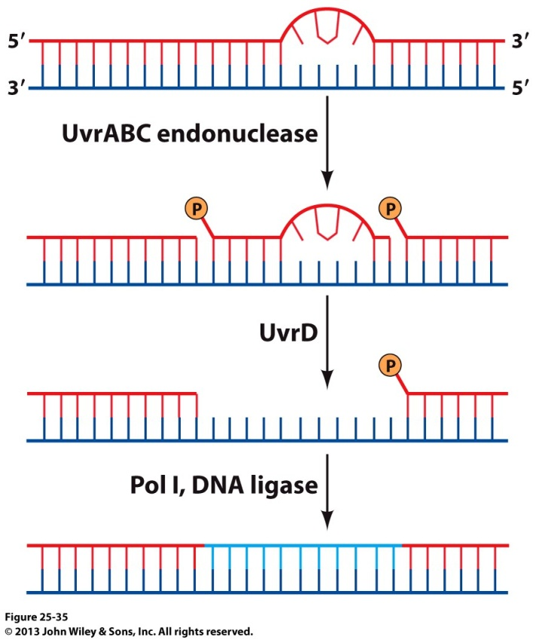
DNA Repair: SSD—Nucleotide Excision Repair (NER)
Should the DR mechanism fail to rectify the thymine dimers or other lesions that result in the distortion of DNA, nucleotide excision repair (NER) kicks in to repair such DNA damage
NER machinery primarily recognizes physical distortions within the double helix as opposed to recognition of specific nitrogenous bases
In NER, a segment of DNA strand (typically between 12-24nt) around the distorted site is excised out and displaced via the action of a cocktail of endonucleases and helicases
The resulting gap is subsequently filled in by DNA polymerases such as polδ, polε and polκ
DNA ligase subsequently seals the nick
Endonucleases
Helicases
Polδ
DNA ligase
Repair of DNA damage resulting from thymidine dimers via NER

Slide 34
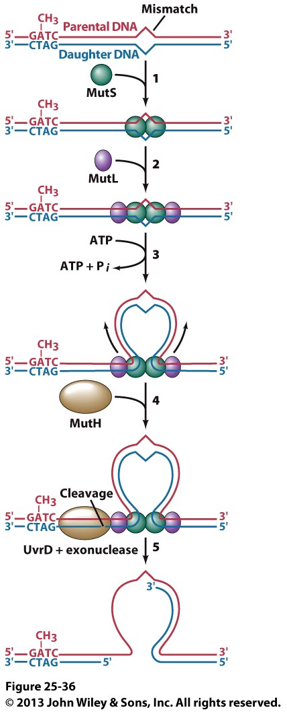
DNA Repair: SSD—Mismatch Repair (MMR)
Were it not for the intervention of mismatch repair (MMR), DNA replication errors would result in a high incidence of genetic disorders such as cancer
Mismatch repair (MMR) represents a second line of defense against DNA replication errors that filter through the “proofreading” action of polδ and polε
MMR machinery can also rectify small insertions/deletions (=< 4nt) arising from the slippage of one strand relative to other within the active site of DNA polymerases
In a nutshell, the MMR machinery excises out a nucleotide segment on the daughter strand harboring a mismatched base pair
In prokaryotes, the daughter strand is distinguished from the parent strand on the basis of the fact that the latter is methylated
In eukaryotes, the MMR machinery is believed to distinguish the daughter strand on the basis of the fact that the newly synthesized leading and lagging strands harbor transient nicks
Bacterial MMR machinery

Slide 35
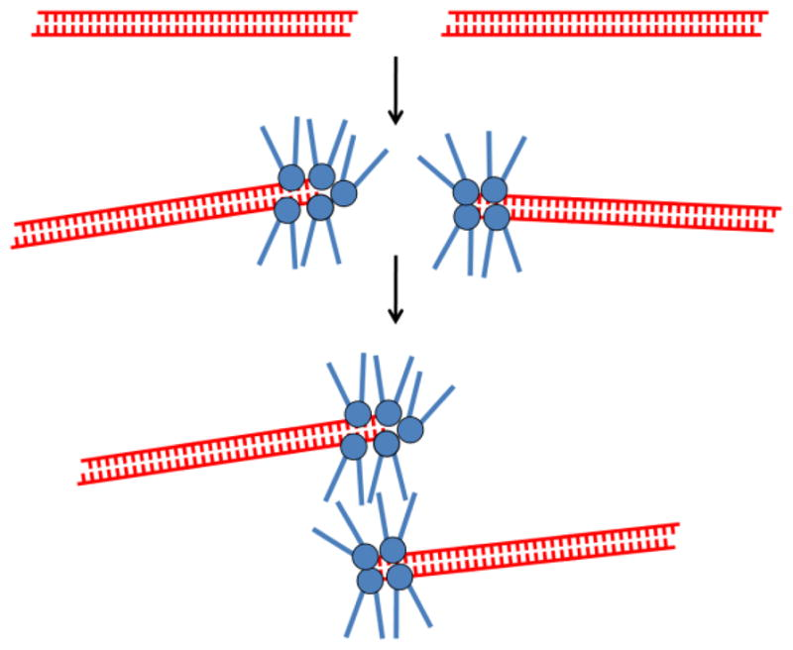
DNA Repair: Double Strand Break (DSB)
DNA is not only susceptible to single
strand damage (SSD) but also to double
strand breaks (DSBs)
Such DSBs are often generated by exposure
to ionizing radiation or the free radical
by-products of oxidative metabolism
Repair of DSBs is essential for they
can cause chormosomal aberrations
leading to cancer
Two common mechanisms involved in
repairing DSBs are referred to as “Homologous
recombination (HR)”, and “nonhomologous
end-joining (NHEJ)”
In both HR and NHEJ, the broken ends of DNA are initially sensed by the so-called MRN complex (MRX in yeast)—comprised of various proteins such as Mre11, Rad50 and Nbs1
MRN complex ultimately triggers the assembly of common players such as nucleases, polymerases and ligases at the site of DSB—thereby resulting in direct ligation of broken ends in the presence (HR) or absence (NHEJ) of a homologous template
Clustering of MRN complex @ the site of DSB

Slide 36
Exercise 4.3c
Describe the role of DNA photolyase in direct reversal?
Describe the role of DNA glycosylase in base excision repair?
Describe similarities and differences between base excision repair and nucleotide excision repair?
Why is mismatch repair so critical for ensuring the fidelity of DNA replication?

